Slide 1
Game Design and Programming
Neil Gannon

Slide 2
Animation Topics
Animation
Animation Types
Playback
Control
Tools
Enumerations
What are they
How do we create them
How do we use them

Slide 3
Animation

Slide 4
Animations
Animations are an important part of modern games
They add life to a game
Allow for more interesting characters and environments
More expression overall
Creating animations can be time consuming
Art skills required
We want to look at the different animation types
What can we use in game maker
What tools are there to life easier

Slide 5


Flipbook (Sprite sheet)
Unity primarily makes use of sprite sheets for animations
A sprite sheet is simply a collection of images that are the same size
Stored in rows and columns
Should have some form of progression
We can control what frames are included in the animation
And we can control the speed at which these are played at

Slide 6
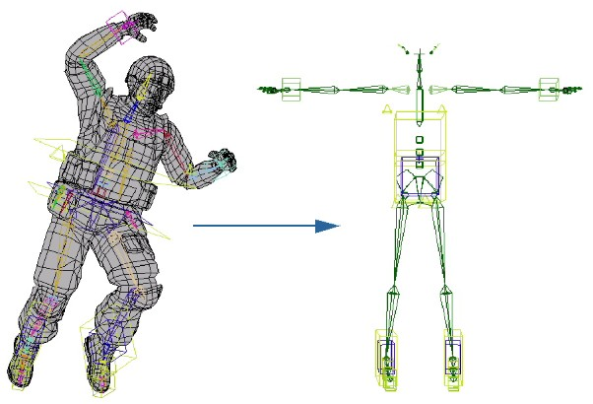
Keyframe
Default animation method in 3D games
3D models have bones
Bones are bound to vertices
When the bone is moved the vertices follow
A keyframe stores
Bone the frame is animating
Matrix of transformations to be applied
Where in the overall the animation is
Similar to flipbook but in a more controlled way

Slide 7
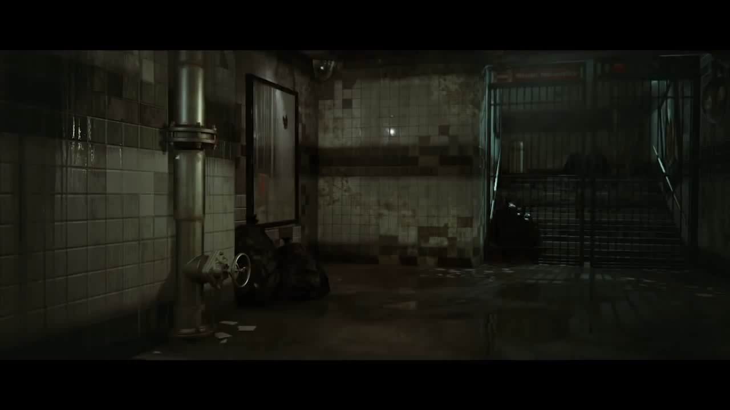
Keyframe Sample

Slide 8
Sprite Sheets

Slide 9
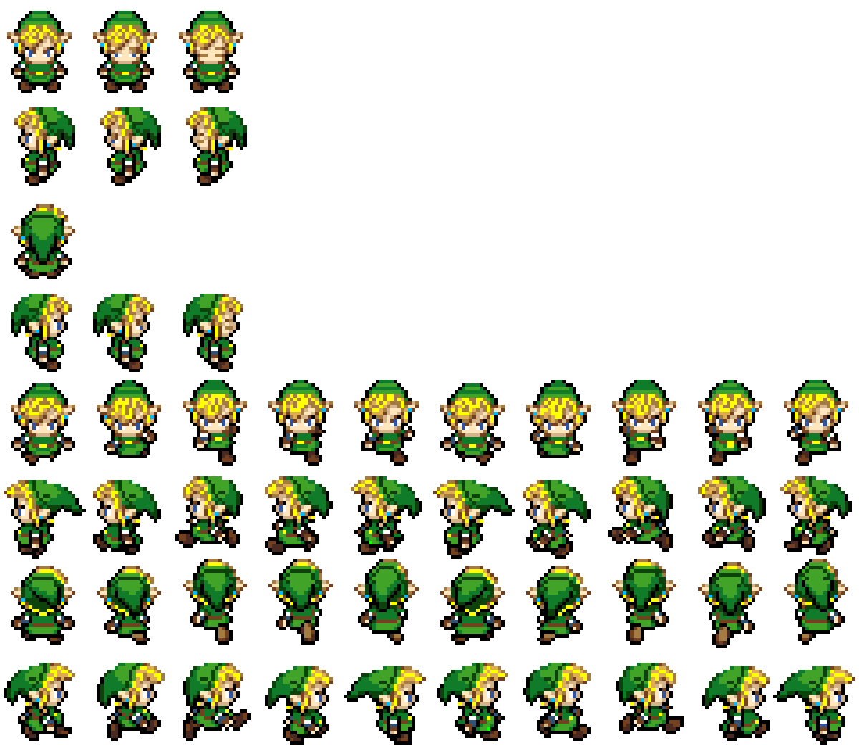
Sprite Sheet
A sprite sheet is a single image file that contains multiple smaller images
These images are commonly referred to as frames
Each row in the sheet can corresponds to a single animation cycle
These animations are linked to an action your character can perform
Walking, Idle, Running, Fighting, Jumping etc.

Slide 10
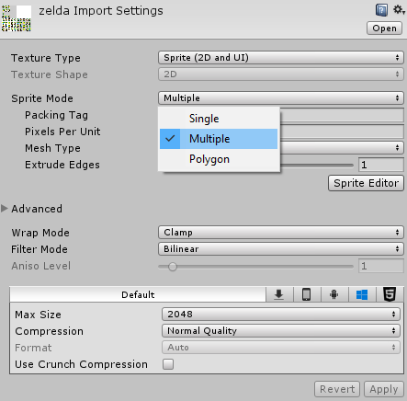
Sprite Mode
By Default Unity treats all sprites as a single image
We know the sheet contains multiple images
By selecting the sprite we can change the Sprite Mode set by Unity
Single
Multiple
After changing the mode we need to apply this change to the asset
Once applied we can open the Sprite Editor to extract the individual frames

Slide 11
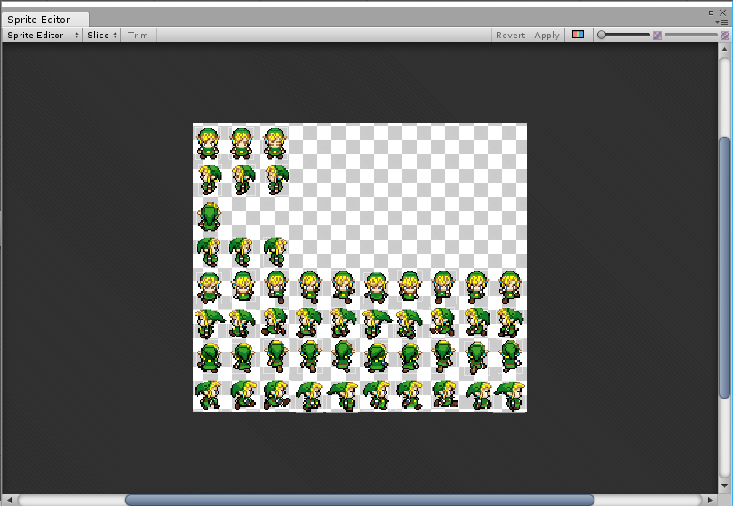
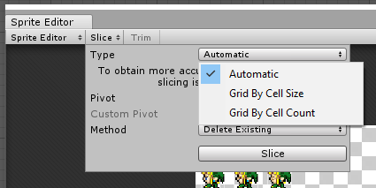
Slicing
The sprite editor provides three modes for extracting frames from the sheet
Automatic
Cell Size
Cell Count
Cell Size requires you to know the width and height of each frame
All frames will be created with these dimensions
Cell count will split the sheet up based on the number of rows and columns you declare

Slide 12
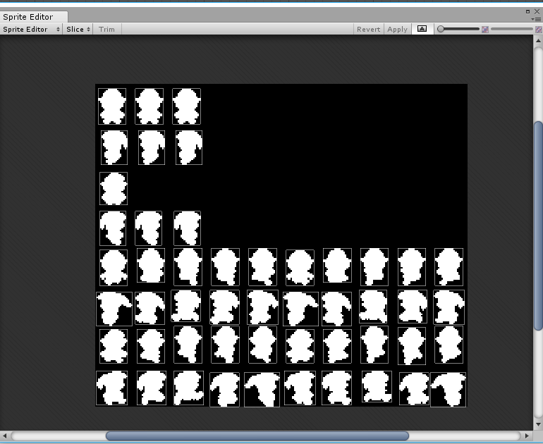
Sliced
To see how the image was sliced click the indicated icon in the top right of the sprite editor window
You are free to modify each frame by selecting it
Can adjust width and height
When you are happy you must click the apply button in the top right
Or close the sprite editor and you will be prompted to apply the changes
You are free to re-slice the frames at any time

Slide 13
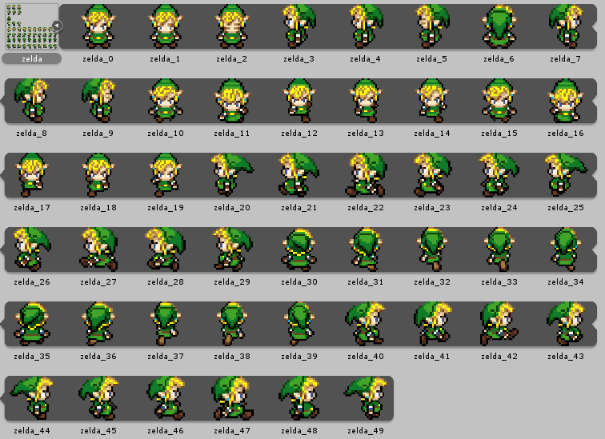
Frames
Once sliced all frames will now be displayed
Click the arrow on the right side of the sprite sheet
The sheet contains multiple animation cycles
You need to select all the frames you want for your animation and drag them into the scene
You will be prompted to save the animation
Give a meaningful name to the animation!

Slide 14
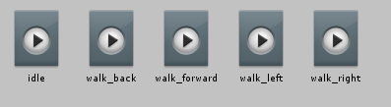
Animations
Two files are generated when saving frames of an animation
Animation File
Animator File
The animations file simply holds a reference to the frames you have selected for that animation
These files are used within the animation state machine
Know as an Animator

Slide 15
Animators

Slide 16
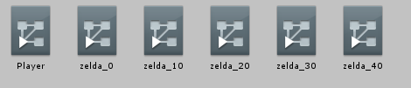
Animators
An animator controls how and when an animation should be played
Each animator can reference multiple animations or just a single one
Typically we have one animator that contains all animations for a character
These animators contain a state machine
Continually checks conditions to determine what animation should be played
We need to manually declare these conditions

Slide 17
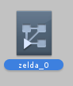
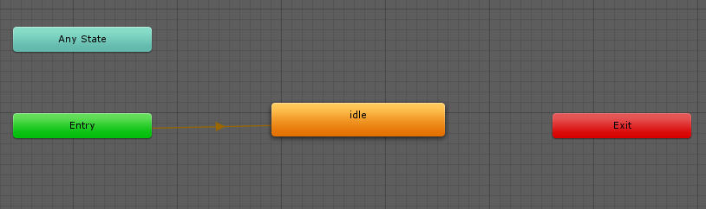
Animator State Machine
Entry
Defines where the state machine begins
Idle
The only animation currently in the state machine
This animation is not connected to any other animations
By default this will loop forever
What if we want multiple animations?
How will we control which one is played?

Slide 18
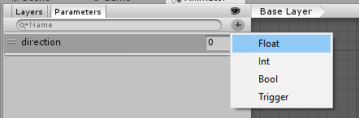
Parameters
We can define input parameters to the state machine
These parameters are just normal variables
Must have a unique name
Can be one of four types
Can be set via a C# script
Hooked into game logic
These parameters are required if we want to be able to switch between various animations

Slide 19
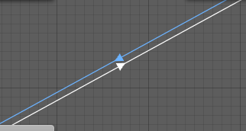
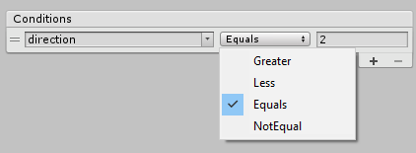
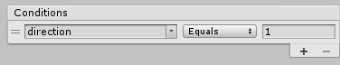
Transitions Conditions
Right clicking on an animation allows us to create a transition
Transitions have conditions that determine what animation should be playing
If Character is Angry then play the Angry animation
If the player is moving right then play the moving right animation
If direction is 2 then player the moving left animation

Slide 20
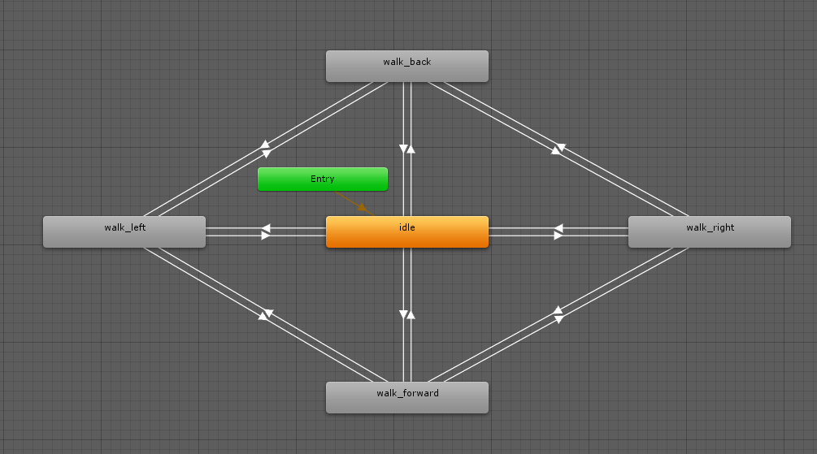
Complete State Machine
A complete state machine can have transitions between all animations
Note I do not have transitions between
Up and Back
Left and Right
These should be added
The state machine will continuously check the direction parameter to determine what animation should be played

Slide 21
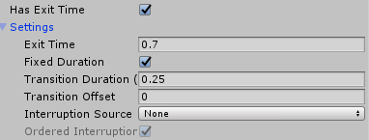
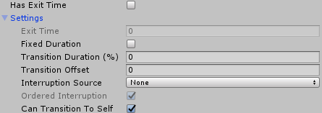
Transition Speed
By default in Unity all transitions have a delay and an exit time
These can have a big effect on the how you game plays
We typically want to remove these delays
Uncheck the Has Exit Time
Uncheck the Fixed Duration
Set Transition Duration to 0
Animations will now switch immediately between each other

Slide 22
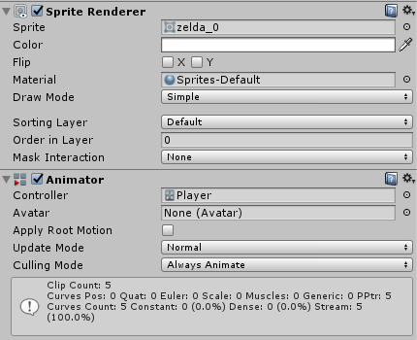
Animator Component
After dragging the animated sprite into the scene the animator component will be added to the object
Note the controller box will have your state machine assigned
If you run the game the default animation will play
We can also access the animator through code and set the parameters directly

Slide 23
Controlling Animators with Scripts

Slide 24
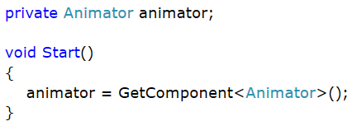
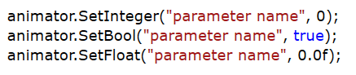
Getting the Animator

Slide 25
Enumerations

Slide 26
Enumerations (Enum)
Sometimes we want to store a constant list of choices/options
A fixed list of custom options
We can only use the options this list provides
An enumeration is a set of named integer constants
A list of named items with an integer index
We only assign the name and the index is automatic (starts at 0)
Index can be changed if desired
A declared enum can be used anywhere in our C# code
Very useful for representing states

Slide 27
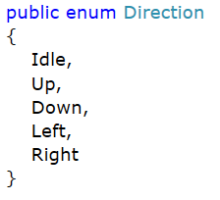
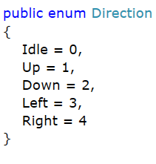
Creation
An Enum can be declared in any script (outside the main curly brackets)
Use the enum keyword followed by curly brackets
Fill in the desired list of options
We can change the integer index by simply using
= new index (integer)
Once declared the enum will be available for use everywhere

Slide 28
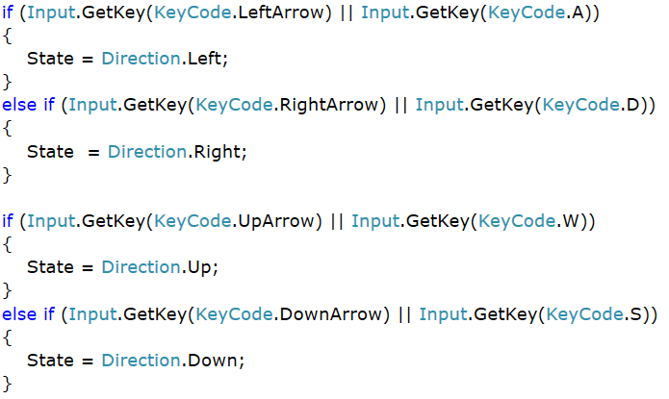
Usage
In the sample shown
We have an enum called Direction
5 possible values
We have a variable called State (enum Direction)
We could have a script the will check what key is pressed and then assign the direction
We can use either an if…else or a switch to determine what the current value is
Do logic based on this

Slide 29
ENUMS and ANimations

Slide 30
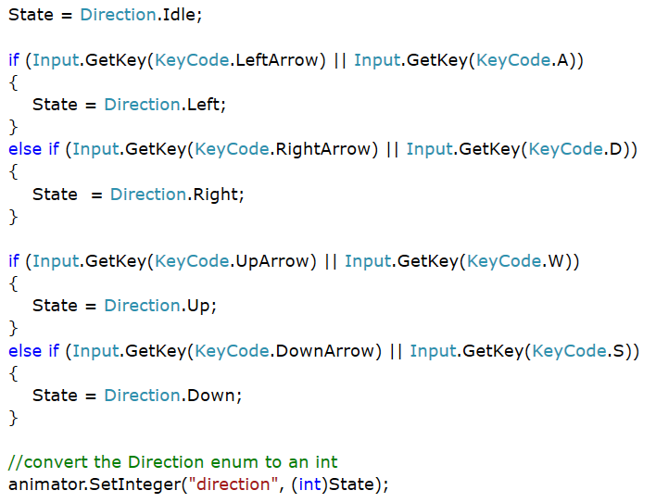
Enums and Animator

